Slide 1
Creating genomic relationship matrices with preGSf90
Daniela Lourenco
UGA USA
Ignacio Aguilar
INIA Uruguay
BLUPF90 TEAM, 02/2022

Slide 2
preGSf90
Performs Quality Control of SNP information
Creates the genomic relationship matrix (G)
and relationships based on pedigree (A₂₂)
Inverse of relationship matrices

Slide 3
BLUP-based models
$$\left[\begin{matrix}\text{X}\text{′}\text{X} & \text{X}\text{′}\text{W} \\ \text{W}\text{′}\text{X} & \text{W}\text{′}\text{W}\text{+}{\text{A}}^{−1}\frac{σ_{e}^{2}}{σ_{a}^{2}}\end{matrix}\right]\left[\begin{matrix}\hat{β} \\ \hat{\text{u}}\end{matrix}\right]=\left[\begin{matrix}\text{X}\text{′}\text{y} \\ \text{W}\text{′}\text{y}\end{matrix}\right]$$
BLUP
Henderson, 1963
$$\left[\begin{matrix}\text{X}\text{′}\text{X} & \text{X}\text{′}\text{W} \\ \text{W}\text{′}\text{X} & \text{W}\text{′}\text{W}\text{+}{\text{G}}^{−1}\frac{σ_{e}^{2}}{σ_{a}^{2}}\end{matrix}\right]\left[\begin{matrix}\hat{β} \\ \hat{\text{u}}\end{matrix}\right]=\left[\begin{matrix}\text{X}\text{′}\text{y} \\ \text{W}\text{′}\text{y}\end{matrix}\right]$$
GBLUP
Nejati-Javaremi et al., 1997
Fernando, 1998
VanRaden, 2008
$$\left[\begin{matrix}\text{X}\text{′}\text{X} & \text{X}\text{′}\text{W} \\ \text{W}\text{′}\text{X} & \text{W}\text{′}\text{W}\text{+}{\text{H}}^{−1}\frac{σ_{e}^{2}}{σ_{a}^{2}}\end{matrix}\right]\left[\begin{matrix}\hat{β} \\ \hat{\text{u}}\end{matrix}\right]=\left[\begin{matrix}\text{X}\text{′}\text{y} \\ \text{W}\text{′}\text{y}\end{matrix}\right]$$
ssGBLUP
Misztal et al. (2009)
Legarra et al. (2009)
Aguilar et al. (2010)
Christensen & Lund (2010)

Slide 4
PreGSf90
Created to construct the matrices using in ssGBLUP
$$G$$
$$G^{−1}$$
$$A_{22}$$
$$A_{22}^{−1}$$
$G^{−1}−A_{22}^{−1}$

Slide 5
Genomic Relationship Matrix - G
$\text{G}\text{ = }\frac{\text{ZZ}\text{′}}{\text{2}\sum{{\text{p}}_{\text{i}}\text{(1}\text{−}{\text{p}}_{\text{i}}\text{)}}}$ (VanRaden, 2008)
Z = matrix for SNP marker
Dimension of Z = n*i
n animals
i markers
Genotype Codes
0 – Homozygous
1 – Heterozygous
2 – Homozygous
5 – No Call (Missing)
SNP file

Slide 6
HOW TO: Creation of Genomic Matrix
Read SNP marker information => M
Get ‘means’ to center
Calculate allele frequency from observed genotypes (p_{i})
p_{i}= sum(SNPcode_{i})/2n
Centered matrix Z = M – 2P
$\text{G} \text{=} \frac{\text{ZZ}\text{′}}{\text{2}\sum{{\text{p}}_{\text{i}}\text{(1}\text{−}{\text{p}}_{\text{i}}\text{)}}}$ (VanRaden, 2008)

Slide 7
Creation of Genomic matrix
Issues
Large number of genotyped individuals
Large number of SNP markers
Matrix multiplication ~ cost n² * i
Large amounts of data put in (cache) memory to do matrix multiplication for each pair of animals and indirect memory access (center)

Slide 8
PreGSf90
Efficient methods
create the genomic relationship matrix and the relationship matrix based on pedigree
Invert the relationship matrices
Computes statistics for the matrices
Means, Var, Min, Max
Correlations between diagonals
Correlations for off-diagonals
Correlations for the full matrices
Regression coefficients

Slide 9
OPTIONS – preGS90 parameter file
PreGSF90
controled by adding OPTION commands to the parameter file
OPTION SNP_file marker.geno.clean
Reads:
marker.geno.clean
marker.geno.clean.XrefID (created by renumf90)
Pedigree file
Map file (optional)

Slide 10
Genomic Matrix default options
$\text{G}\text{0}\text{ = }\frac{\text{ZZ}\text{′}}{\text{2}\sum{{\text{p}}_{\text{i}}\text{(1}\text{−}{\text{p}}_{\text{i}}\text{)}}}$ (VanRaden, 2008)
With:
Z centered using current allele frequencies
Current genotyped animals

Slide 11
Genomic Matrix Options
OPTION whichfreq x
0: read from file freqdata or other specified name (needs OPTION FreqFile)
1: 0.5
2: current calculated from genotypes (default)
OPTION FreqFile file
Reads allele frequencies from a file

Slide 12
Genomic Matrix default options
Blending - to avoid singulatiry problems
G = 0.95*G₀+ 0.05*A₂₂
OPTION AlphaBeta 0.95 0.05 #(default)
Beta may vary from 0.2 to 0.01

Slide 13
Genomic Matrix default options
Tuning
Adjust G to have mean of diagonals and off-diagonals equal to A₂₂
OPTION tunedG 2 #(default) Chen et al. (2011)
Base of GBLUP is genotyped animals
Base of pedigree is founders of the pedigree
For SSGBLUP modelled as a mean for genotyped animals
$p\left(u_{2}\right)=N\left(1μ,G\right)$
Integrate $μ$ : $G^{∗}=11′\text{λ}+(1−{\text{λ}}/2)G$
$μ$ = (Genomic base) – (Pedigree base)
Vitezica et al. 2011

Slide 14
Options for matching G to A₂₂
OPTION tunedG x
0: no adjustment
1: mean(diag(G))=1, mean(offdiag(G))=0
2: mean(diag(G))=mean(diag(A₂₂)),
mean(offdiag(G))=mean(offdiag(A₂₂)) (default)
3: mean(G)=mean(A₂₂)
4: Use Fst adjustment. Powell et al. (2010) & Vitezica et al. (2011)
$$G^{∗}=11′\text{λ}+(1−{\text{λ}}/2)G$$

Slide 15
Storing and Reading Matrices
preGSf90 saves by default (file: GimA22i)
$G^{−1}−A_{22}^{−1}$
To save ‘raw’ genomic matrix:
OPTION saveG [all]
If the optional all is present all intermediate G matrices will be saved!!!
To save G⁻¹
OPTION saveGInverse
Only the final G, after blending, scaling, etc. is inverted !!!
To save A₂₂ and inverse
OPTION saveA22 and OPTION saveA22Inverse

Slide 16
Storing and Reading Matrices
OPTION saveG [all] , OPTION saveGInverse, …
Saves in binary format
“Dumped” format to save space and time
To save as row, column, value:
OPTION no_full_binary
Still binary, but can be easily read and converted to text

Slide 17
Storing with Original IDs
Some matrices could be stored in text files with the original IDs extracted from renaddxx.ped created by the RENUMF90 program (col #10)
For example:
OPTION saveGOrig
OPTION saveDiagGOrig
OPTION saveHinvOrig
Values
origID_i, origID_j, val

Slide 18
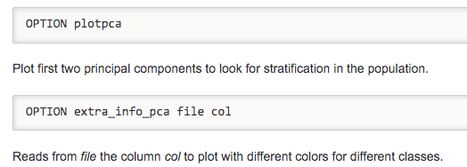
Genomic Matrix - Population structure

Slide 19
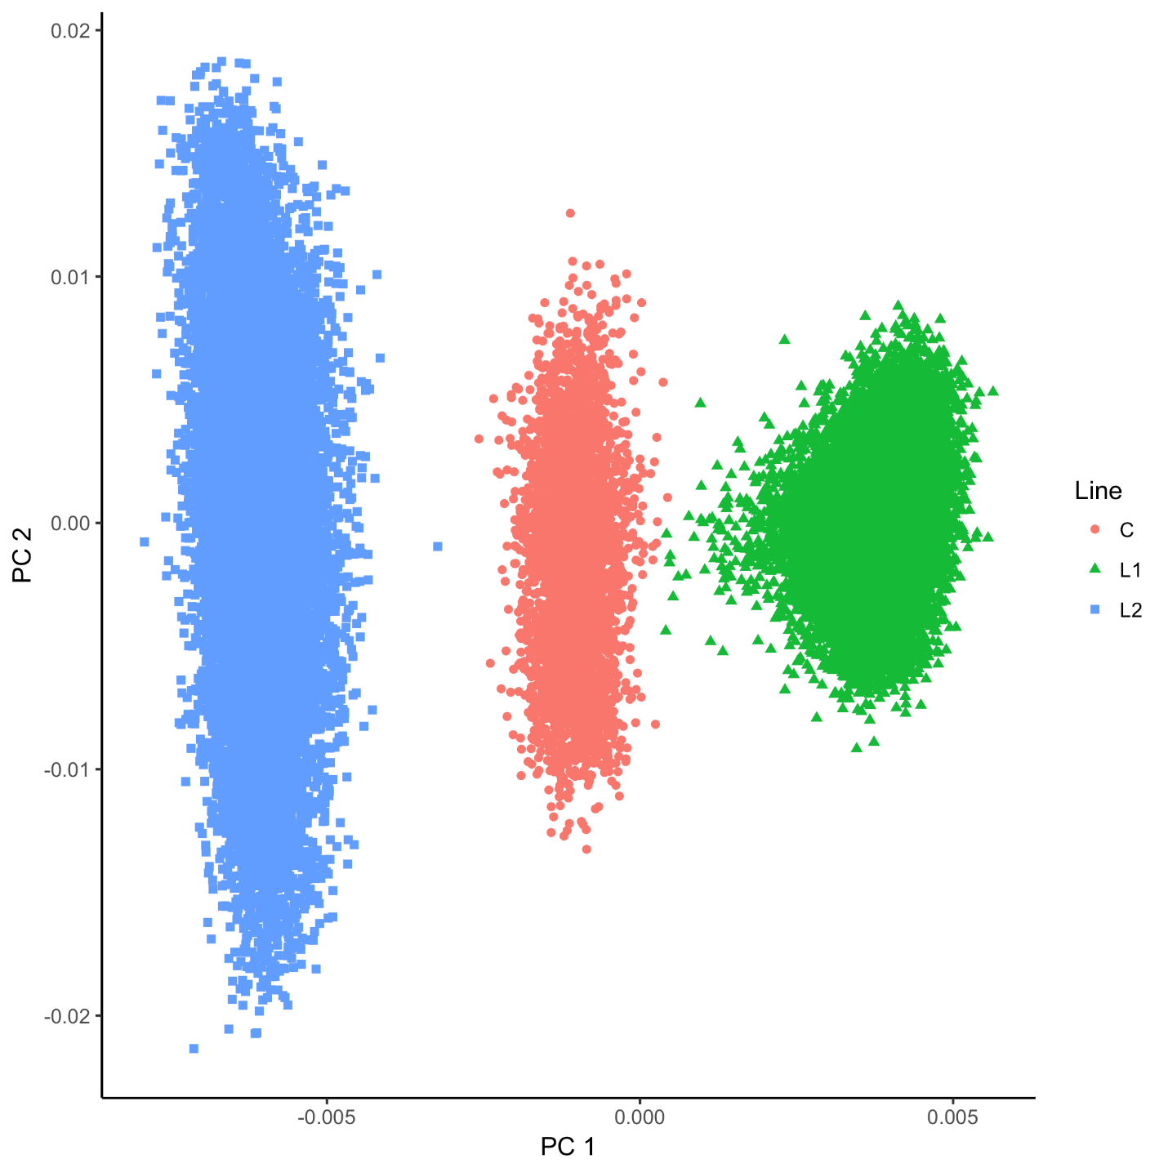
Genomic Matrix - Population structure

Slide 20
Tricks to setup G for GBLUP
Tricks are needed because preGSf90 is set up for ssGBLUP
1) Use a dummy pedigree
1 0 0
2 0 0
…
2) Use PED_DEPTH 1 in renumf90
3) Change blending parameters
OPTION AlphaBeta 1.00 0.00 → G = 1.00*G + 0.00*I
OPTION AlphaBeta 0.99 0.01 → G = 0.99*G + 0.01*I
4) No adjustment for compatibility with A₂₂
OPTION tunedG 0

Slide 21
Tricks to setup G for GBLUP
Yet another way to run GBLUP in BLUPF90
1) In renum.par, remove any information about the pedigree. Example:
FILE
pedigree.txt
FILE_POS
1 2 3 0 0
PED_DEPTH
3
3) Change blending parameters
OPTION AlphaBeta 1.00 0.00 → G = 1.00*G + 0.00*I
OPTION AlphaBeta 0.99 0.01 → G = 0.99*G + 0.01*I
4) No adjustment for compatibility with A₂₂
OPTION tunedG 0

Slide 22
PreGSf90 inside BLUPF90 ??
Almost all programs from BLUPF90 support the creation of genomic relationship matrices
OPTION SNP_file xxxx
Why preGSF90 ?
Same genomic relationship matrix for several models, traits, etc.
Just do it once and store GimA22i

Slide 23
Use in application programs
Use renumf90 for renumbering and creation of XrefID and files
SNP_FILE
marker.geno
Run preGSf90 with quality control, saving clean files
Option 1:
run blupf90 with clean files
Option 2:
run preGSf90 with clean files (program saves GimA22i)
run blupf90 with option to read GimA22i from the file

Slide 24
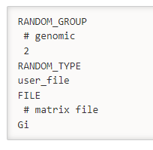
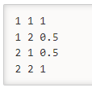
Reading external matrices
BLUPF90 programs accept external matrices created outside
http://nce.ads.uga.edu/wiki/doku.php?id=user_defined_files_for_covariances_of_random_effects
File should be row, column, value in plain text format (lower OR upper triangular)
user_file: if providing the inverse of the covariance structure
user_file_inv: if the program has to invert the covariance structure
renf90.par
Valid format
Non-valid format

