Slide 1
PreGSf90 for Quality Control of SNP data
Andres Legarra
INRA France
Ignacio Aguilar
INIA Uruguay
Daniela Lourenco
UGA USA
UGA TEAM, 08/2019

Slide 2
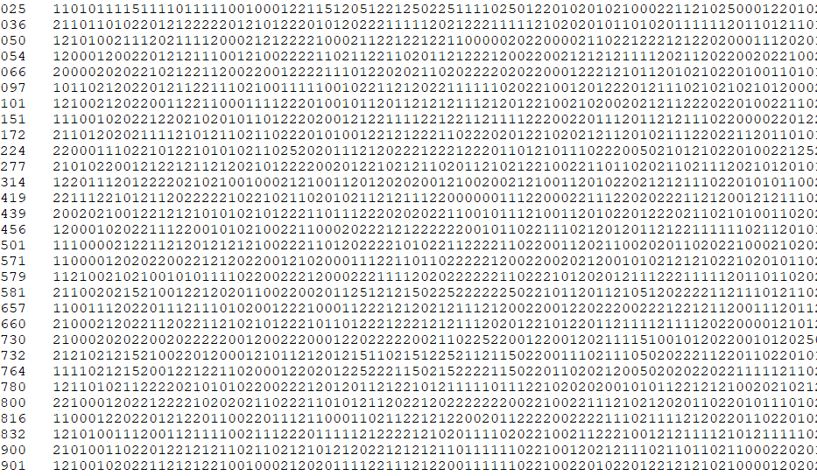
SNP data

Slide 3
Call rate
Is the percentage of observed (non-missing) genotypes:
per animal (per row)
per SNP marker (per column)
In other words, the number of “5”s
If call rate of an animal <90%
genotype of the animal is rejected (delete line)
If call rate for a marker <90%
marker is deleted (delete column)

Slide 4
SNP
ANIMAL

Slide 5
Allele Frequency
The allele frequency $p$ is simply the frequency of the reference allele
30 animals = 60 alleles
0 = AA
1 = AB
2 = BB
How many copies of B:
(1+2+1+1+1+…+1)/60
or
Average/2
Allele frequency of B = 0.7167
Allele frequency of A = 0.2833

Slide 6
Minor allele Frequency
MAF is the lowest of the two allele frequecies
$p=freq\left(A\right)$
$q=1−p=freq\left(B\right)$
$MAF=min(p,q)$
Why is MAF important?
A fixed marker ($p=0$ or $p=1$) gives no information
An almost-fixed marker ($p=0.0001$ or $p=0.9999$) gives almost no info
Common sense: delete markers with MAF<0.01 or <0.05
For prediction and GWAS it does not make much difference
For sequence analysis with de novo variants it makes a difference

Slide 7
Hardy-Weinberg Equilibrium
If animals reproduce at random we expect to find HW proportions of genotypes:
$$p^{2}, 2pq, q^{2}$$
We can use a Chi-square test to test this, but
Does HWE equilibrium this hold?
Only approximately
At each generation $p$ changes a little bit, so it does not hold across all generations
Also, animals do not mate at random

Slide 8
Hardy-Weinberg Equilibrium
Rule of thumb used by AIPL (Wiggans 2011):
Number of heterozygotes should not deviate too much
Delete marker if $\left|\frac{n of heterozygotes}{n}−2pq\right|>0.15$

Slide 9
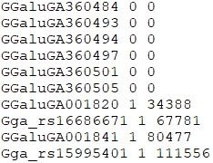
Non-mapped SNP
SNP markers are in chromosomes
The position of some SNP is still unknown!
This is reported as “chromosome 0”
It is better to remove these markers

Slide 10
Mendelian conflicts
In absence of mutation (which is rare) this kind of inheritance is not possible:
AA
AA
AA
BB
AB

Slide 11
Mendelian conflicts
If a marker is seen in many Mendelian conflicts,
possibly the genotyping of the marker is wrong and the marker is deleted
If an animal is seen in many Mendelian conflicts,
Possibly there is a misidentification in animal or in pedigree
You may try to find this animals’ parent:
seekparentf90

Slide 12
Duplicate genotypes
Two animals should not have identical SNPs unless they are clones or monozygotic twins
Duplicated genotypes come from mislabeling: the DNA sample of the same animal has been given two different IDs

Slide 13
Linkage disequilibrium
« Gametic phase disequilibrium »
Statistical association between alleles at two loci in the same chromosome
Loci : places
Alleles: alternative forms of a gene (A,B,0)
Phase: notion of being in the same chromosome (of a pair) or coming from same origin (sire or dam)

Slide 14
Linkage disequilibrium
p(A)=0.6
p(B)=0.5
if independent, p(AB)=0.3,p(ab)=0.2
The expected proportions are:
A a
B 0.3 0.2
b 0.3 0.2

Slide 15
Linkage disequilibrium
p(A)=0.6
p(B)=0.5
in reality:
A a
B 0.4 0.2
b 0.1 0.3
vs. expected
A a
B 0.3 0.2
b 0.3 0.2
More AB & ab than expected !!
This is linkage disequilibrium (statistical concept)

Slide 16
Linkage disequilibrium
Is a statistical concept
Describes not-random association of two loci
Nothing more, so, why is it useful?
Two loci in LD most often are (very) close
This is because LD breaks down with recombination
Linkage disequilibrium of two loci decays on average with the distance
Where does it come from?
Because chromosomes are transmitted together
Within known families (« linkage analysis »)
Within the history of a population (« populational linkage disequilibrium » or « linkage disequilibrium » in short)

Slide 17
Measures of LD: r²
if we use « gene content »
« A » = 1, « a »=0
« B » = 1, « b »=0
r is the correlation between two loci
Not free from problems but can be understood by statisticians (and breeders)
The sample size needed to achieve a given power is proportional to $1/r^{2}$ (Pritchard Przeworski 2001 Am J Hum Genet 69:1)
Everybody uses it to describe things in genomic selection

Slide 18
preGSf90
Interface program to the genomic module to process the genomic information for the BLUPF90 family of programs
Performs Quality Control of SNP information
Creates the genomic relationship matrix
and relationships based on pedigree
Inverse of relationship matrices

Slide 19
preGSf90
Controlled by adding OPTION to the parameter file
OPTION SNP_file marker.geno
Read 2 extra files (besides data and pedigree):
marker.geno
marker.geno_XrefID (created by renumf90)

Slide 20
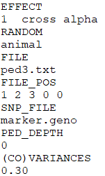
Run renumf90 before preGSf90
Use renumf90 for renumbering and creation of XrefID and files

Slide 21
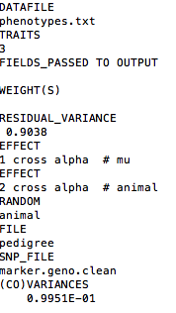
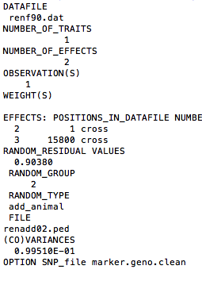
Parameter files
RENUMF90
renum.par
BLUPF90
renf90.par

Slide 22
Pedigree file from RENUMF90
1 - animal number
2 - parent 1 number or UPG
3 - parent 2 number or UPG
4 - 3 minus number of known parents
5 - known or estimated year of birth
6 - number of known parents;
if animal is genotyped 10 + number of known parents
7 - number of records
8 - number of progenies as parent 1
9 - number of progenies as parent 2
10 - original animal ID

Slide 23
SNP file & Cross Reference Id
SNP File
First col: Identification, could be alphanumeric
Second col: SNP markers {codes: 0,1,2 and 5 for missing}
Renumber ID
Cross Reference ID
Pedigree File (from RENUMF90)
Original ID

Slide 24
Output Files from preGSf90
freqdata.count
Contains the estimated allele frequency before QC
freqdata.count.after.clean
Contains allele frequencies as used in calculations, remove code
For removed SNP these will be zero
Gen_call_rate
List of animals removed by low call rate
Gen_conflicts
Report of animals with Mendelian conflicts
GimA22i
Stores the content of the $G^{−1}−A_{22}^{−1}$
Only if preGSf90 is used, not in applications programs

Slide 25
Quality control default exclusion
MAF
SNP with MAF < 0.05
Call rate
SNP with call rate < 0.90
Individuals with call rate < 0.90
Monomorphic
Excludes monomorphic SNP

Slide 26
Quality control default exclusion
Parent-progeny conflicts (SNP & Individuals)
Exclusion -> opposite homozygous
For SNP: Number of parent-progeny exclusion from the total of pairs evaluated (>10 % )
For Individuals: Number of parent-progeny exclusions as percentage of all SNP (> 1%)

Slide 27
Parent-progeny conflicts
Presence of these conflicts results in a negative H
Problems in estimation of variance components by REML, programs do not converge, etc.
Solution:
Report all conflicts, with counts for each individual as parent or progeny to trace the conflicts
Remove progeny genotype
maybe not the best option
But results in a positive-definite H

Slide 28
Parent-progeny conflicts
OPTION verify_parentage x
0: no action
1: only detect
2: detect and search for an alternate parent; no change to any file. Not implemented
implemented in seekparentf90 program
3: detect and eliminate progenies with conflicts (default)

Slide 29
Control default values
For MAF
OPTION minfreq x
Call rate
OPTION callrate x
OPTION callrateAnim x
Mendelian conflicts
OPTION exclusion_threshold_snp x
OPTION exclusion_threshold x

Slide 30
Other Options
Exclusion of selected chromosomes:
OPTION excludeCHR n1 n2 n3 ...
Inclusion of selected chromosomes:
OPTION includeCHR n1 n2 n3 ...
Exclude samples from analyses
OPTION excludeSample n1 n2 n3 …
Inform which are sex chromosomes:
OPTION sex_chr n
Chromosome >= n will be excluded only for HWE and parent-progeny checks, but not in calculations

Slide 31
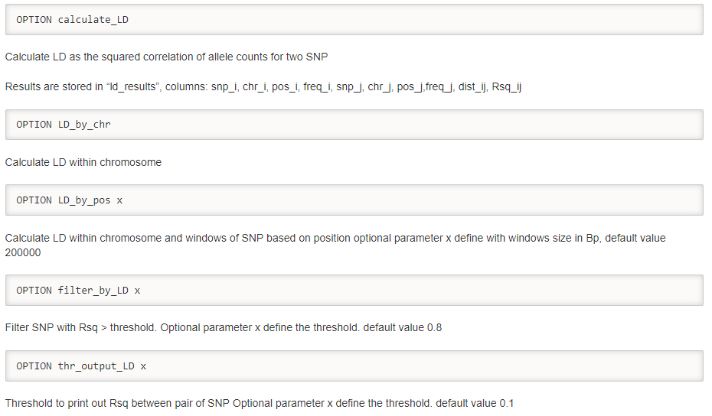
LD calculation and options

Slide 32
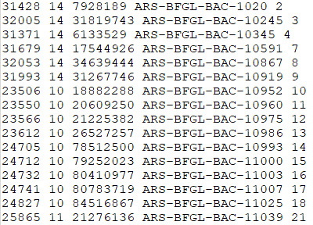
SNP map file
OPTION chrinfo <file>
For some genomic analyses (GWAS) or QC
Format:
SNP number
Index number of SNP in the sorted map by chromosome and position
Chromosome number
Position
SNP name (Optional)
First column is like a header for the SNP file!

Slide 33
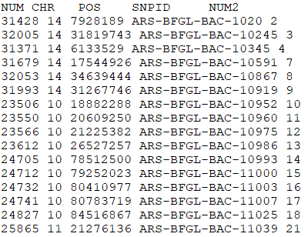
SNP map file – new default
OPTION chrinfo <file>
OPTION map_info <file>
Format:
No defined position if a header is provided
Names for SNP, chromosome, and physical position are mandatory
SNPID for SNP
CHR for chromosome
POS for position

Slide 34
Saving ‘clean’ files
SNP excluded from QC are set as missing (i.e. Code=5)
5 is replaced by 0 in calculations
OPTION saveCleanSNPs
Save clean genotype data with excluded SNP and individuals
For example for a SNP_file named gt.snp
Clean fles will be:
gt.snp_clean
gt.snp_clean_XrefID
Removed SNP/animals will be output in files:
gt.snp_SNPs_removed
gt.snp_Animals_removed

Slide 35
Only QC in preGSf90
Quality control
Genomic relationship matrix
How to do only QC avoiding the inverses:
OPTION SNP_file marker.geno
OPTION saveCleanSNPs
OPTION createGInverse 0
OPTION createA22Inverse 0
OPTION createGimA22i 0

Slide 36
No Quality control
ONLY use:
If QC was performed in a previous run
and “clean” genotype file is used
OPTION SNP_file marker.geno_clean
OPTION no_quality_control

Slide 37
Use in application programs
Use renumf90 for renumbering and creation of XrefID and files
SNP_FILE
marker.geno
Run preGSf90 with quality control, saving clean files
Run further programs as needed
blupf90, airemlf90, gibbs2f90, …

Slide 38
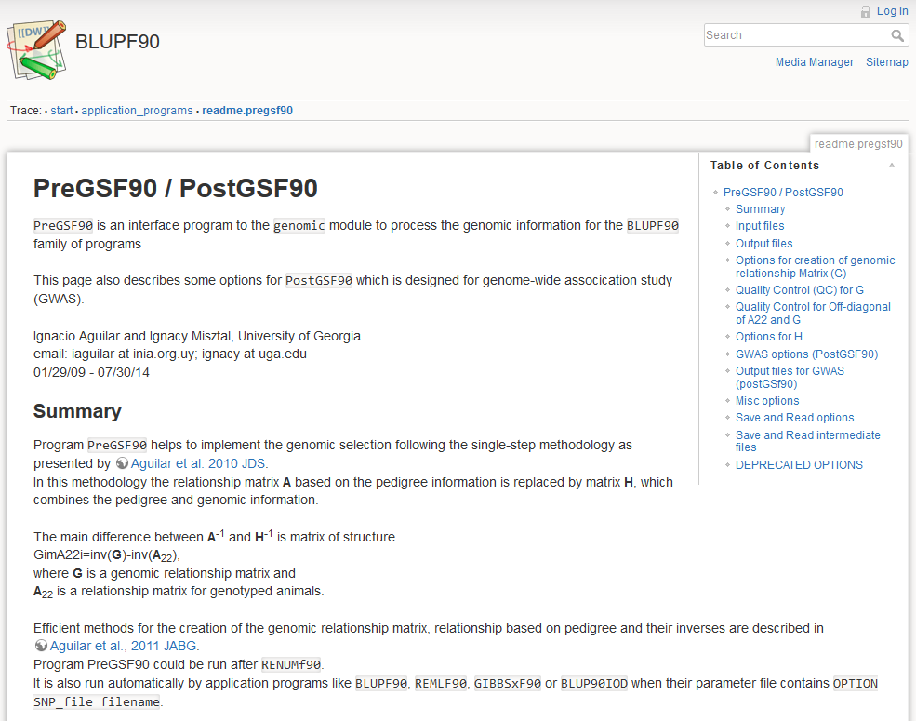
PreGSf90 wiki

